Slide 1
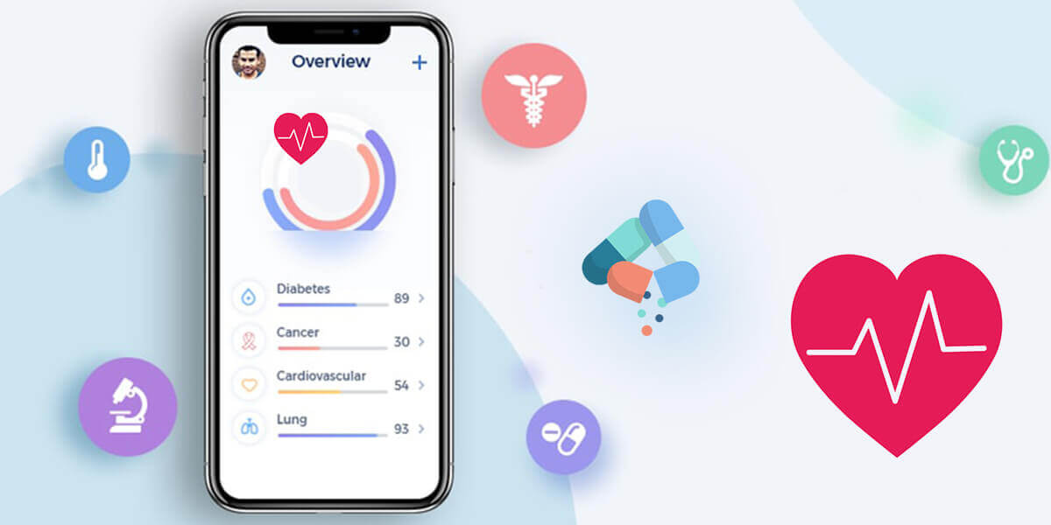
Healthcare Development -Med O’clock
Notes:
Effective

Slide 2
Healthcare Industry Overview
Healthcare professionals now have realised how mobile apps can change their lives. They have understood the importance of mobile applications in the healthcare industry.
In the modern times, hugely efficient and speedy healthcare services are in demand. These mobile applications can help providing industry the solution to this demand.
If you are looking to expand the reach and the delivery mechanism of health related services, then the investment in healthcare mobile application is the way to go.

Slide 3
Why do you need to develop a Med O’clock?
More than 60 percent of the world population use smartphones.
Most of them have the access to internet and which is why mobile applications have become popular.
Healthcare services are one of the biggest untapped market in the context of mobile app services.
This sector is assumed to grow by 300-350 per cent in less than 5 years.
Overall these mobile apps can help improve the healthcare industry, making the service speedy and cost effective.

Slide 4
Healthcare Development
Benefits
Features
1. Helpful to residents of remote areas
2. Helpful to doctors
3. Decline in medical expenses
4. Decreases chance of wrong diagnosis
5. New Business Model and Opportunities
6. Can be used as a Medical Assisstant
1. Telemedicine
2. Appointment manager
3. Surgery updates
4. Medicine ordering
5. User-friendly interface
6. Prescription reminder

Slide 5
Team Members
Vyjayanthi K S : USN - 1KS18CS120
Krithika K N : USN – 1KS18CS034
Ramya R : USN – 1KS18CS077

Slide 6
Thank you :)

